Slide 1
Social Ties in Friendship Networks
Community Identification and Romantic Partnerships
Graphs and Network Flows
Professor Roychowdhury

Slide 2
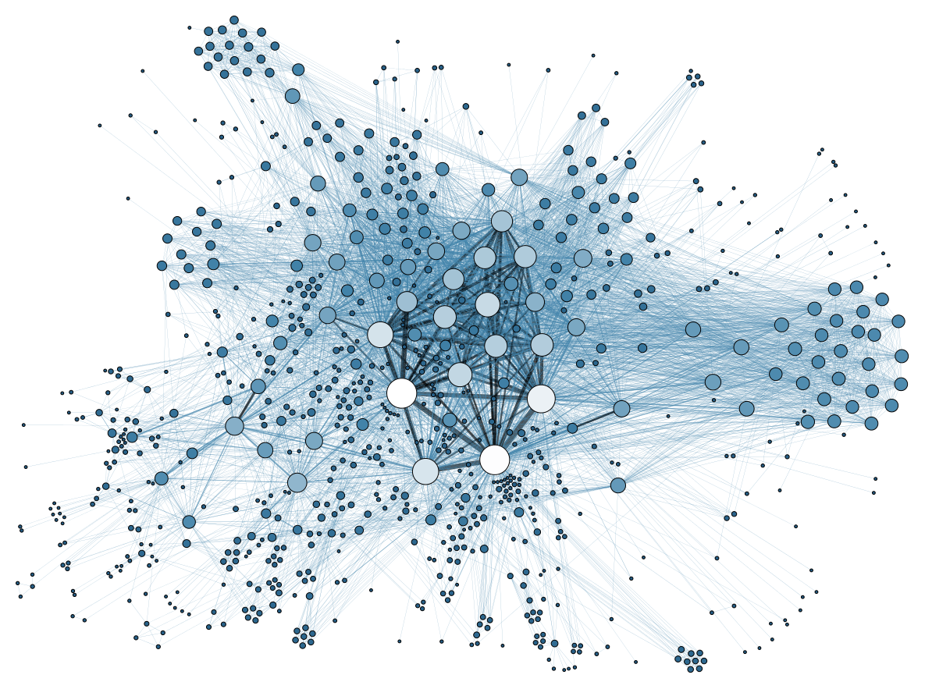
Social Network Analysis
A network of 4039 users, based on 10 personal networks, where any two users are connected through at most 7 intermediate nodes (Diameter 8) and the average degree is 43.7

Slide 3

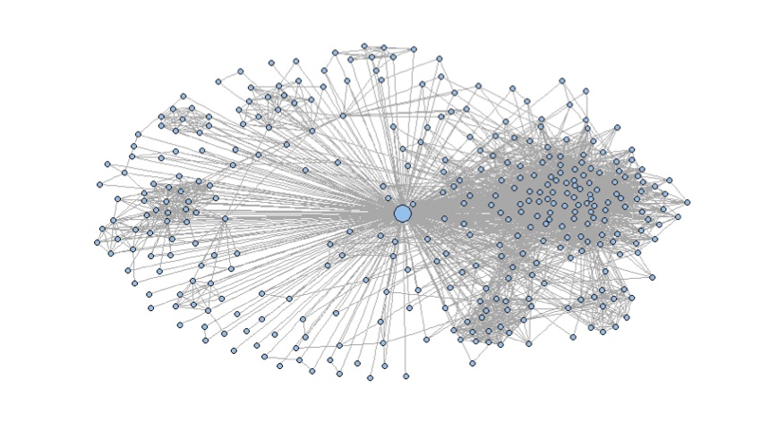
Personal Network of the core nodes
There are 40 nodes which have more than 200 friends with average degree 280
Zooming in to the personal network of a core user we investigate social ties within this network of 348 users

Slide 4
Community Detection
 | Number of Communities | Modularity
Fast Greedy | 8 | 0.413
Edge Betweenness | 41 | 0.353
Infomap | 26 | 0.389
Fast Greedy algorithm is based on a greedy search for finding the best clustering that maximizes the modularity of the network
Edge betweenness is based on removing the edges that lie between two communities. These edges has a large graph theoretic measure called betweenness
Infomap algorithm is based on compressing the probability flow of a random walk and finding the best clustering to minimize the compression efficiency(description length)

Slide 5
Community Identification
Communities found by the fast greedy algorithm, identified by labels, versus the communities found by the edge-betweenness algorithm, identified by colors
Comparison by Jaccard distance between corresponding communities
( |A ∩ B| / |A ∪ B| )
Both of the algorithms have identified communities 7 and 8
The corresponding community to community 6 in fast greedy has another member from Community 1. Thus, d_{jaccard}=12/13
The big community found in EB includes the whole of community 2 and most of community 3 in FG except 3 nodes
Community 4 in FG is precisely the union of two other communities in EB
Community 5 in FG is deconstructed into 3 different communities in EB
Community 1 in FG is scattered all around but EB puts them into different communities

Slide 6
Community Identification
Let us compare Fast greedy algorithm with Infomap algorithm
As in the case of Edgebetweenness, communities 7 and 8 in FG turn out to correspond to the same communities with Infomap
In the info map algorithm we observe almost the same structure as in EB, except the big community does not include community 2 as a whole and 2 nodes are left out for another community. Also, community 3 is further broken into different communities
Community 6 corresponds to the same community in Infomap as in EB with Jaccard distance 12/13
Communities 4 and 5 has the same structure as before except some nodes that are left out in another community in Infomap algorithm.

Slide 7
Communities in the absence of the Core Node
 | Numver of Communities | Modularity
Fast Greedy | 26 | 0.441
Edge Betweenness | 50 | 0.416
Infomap | 40 | 0.418

Slide 8
The Effect of the Core Node
Fast-Greedy algorithm appears to be the most sensitive when removing the core node.
Communities of the Fast-Greedy algorithm in absence of the core node, in color, versus the communities in the presence of the core node, labeled.
As before, Communities 1 and 3 are spread around and community 2 is preserved along with some nodes from communities 1 and 3 in the middle community in the absence of core node
Community 5 is included in the other big red community on the left with Jaccard distance 31/39
The communities 7 and 8 in FG are preserved even after removing the core node
Community 4 is included in the big community on the left with Jaccard distance 20/27

Slide 9
Embeddedness and Dispersion

Slide 10
Identifying Romantic partner
Maximum Embeddedness and Dispersion and their ratio

Slide 11
Identifying the type of communities
Community features
Size of the Community
A measure of connectivity and density of edges
e.g. Average degree/Number of nodes
3) A measure of modularity
Fraction of edges that fall within the communities versus the expected such fraction in random edge assignment
4) Clustering coefficient
Fraction of triangles to triplets

Slide 12
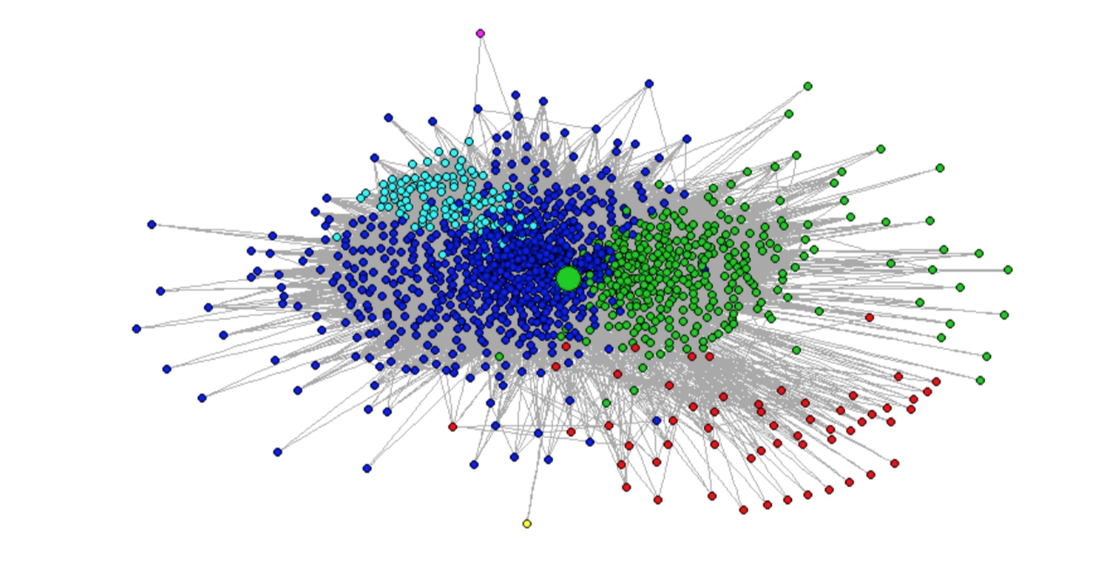
Google+ communities
1) Directed network of users (user A can have user B in his network even if user A isn't in user B's network)
2) Grouping the users that a user follows

Slide 13
Personal Networks in Google+
Take a particular user’s personal Network who groups people in self-created circles
Circle | Size of Circle
1 | 52
2 | 245
3 | 493
4 | 204
No circle | 488
Algorithm | Number of communities | Size of the Communities | Modularity
Infomap | 4 | 1141,24,18,5 | 0.0031
Walktrap | 6 | 57,329,684,116,1,1 | 0.1817
One can find communities in this personal network using generic community detection algorithms and observe how these circles match with those communities.

Slide 14
Walktrap Algorithm
Light Blue | Dark Blue | Green | Red | Outliers
Highly interconnected | Interconnected with a so many outliers | Typically dense with a few outliers | Sparse | Two isolated nodes from the rest
Club or honors society | High school friends | College friends | Outsiders

Slide 15
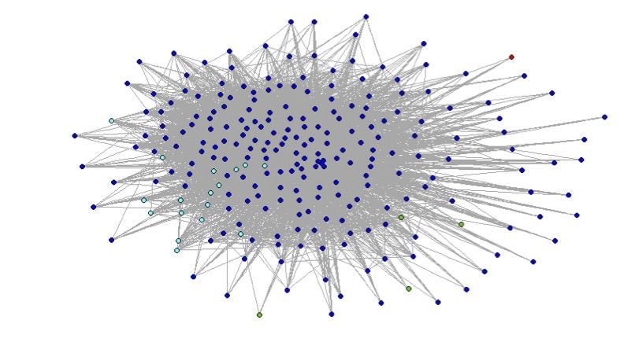
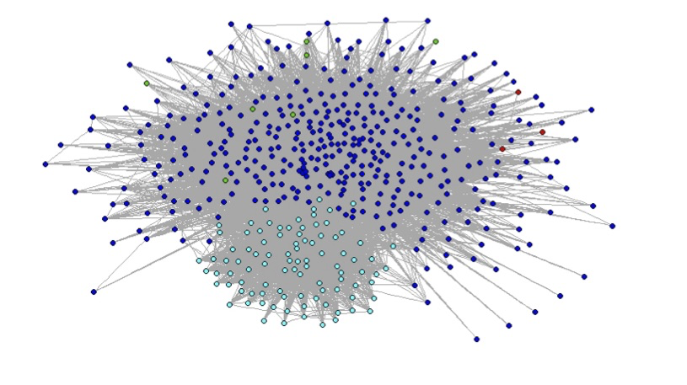
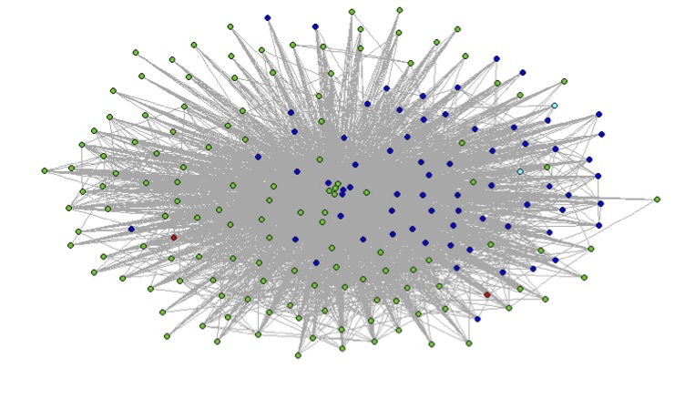
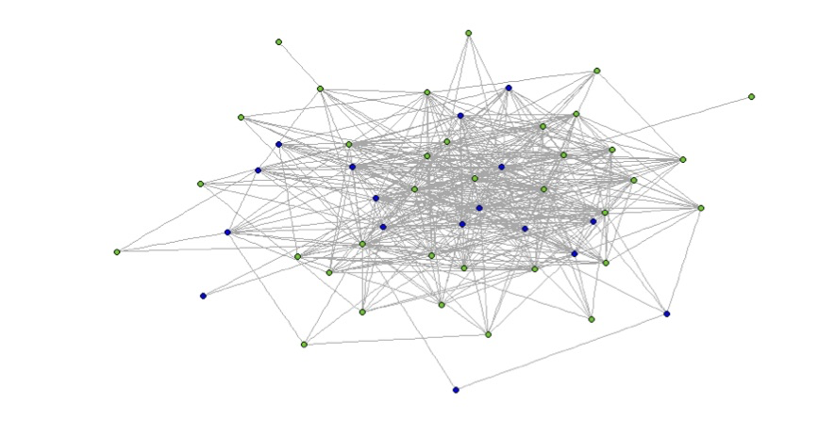
Interpreting the Communities
Circle 1: Perhaps closest friends circle with nodes from high school and college friends
Circle 2: Perhaps a club among high school or college friends
Circle 3: The same interpretation as in the previous case
Circle 4: This circle is interesting, members are repeats of the previous circles, who can correspond to people from a particular group with certain beliefs

